Slide 1
Management plan
for alternative freshwater source
for domestic consumption in Singapore

Slide 2
Agenda
01
Background/Problem statement
02
Visualization
03
Findings
04
Conclusion/Recommendation

Slide 3
Water is a prerequisite for every lives.

Slide 4
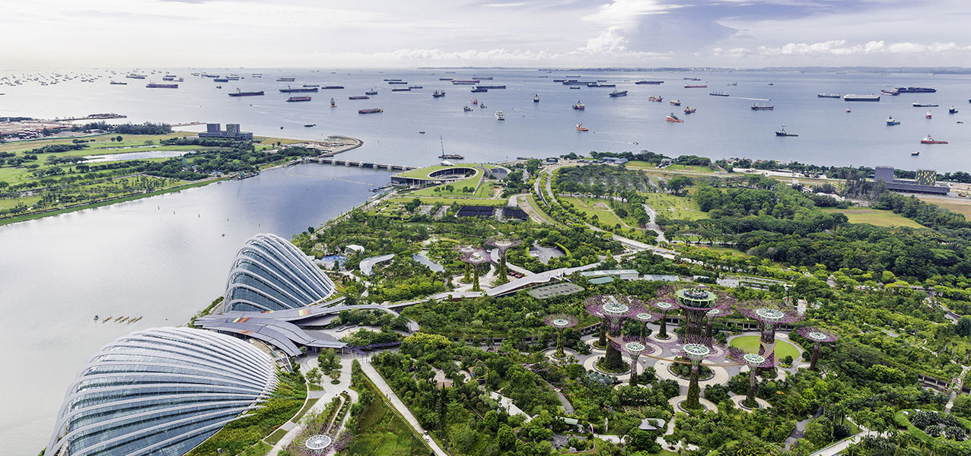
Background
Singapore is a small island country in Southeast Asia located near by the equator where the climate is characterised by two main monsoon seasons separated by inter-monsoonal periods. 1.) Northeast Monsoon: from December to early March, 2.) Southwest Monsoon: from June to September. It regularly faces freshwater shortages with limited freshwater resources from natural sources, which must rely on other water sources to meet the needs of people and industry.

Slide 5
Problem statement
Singapore government is looking for alternative sources of fresh water available in the country from natural water sources, such as rainwater, to produce tap water, an essential driving force in planning the development of long-term water security. The project aims to analyze Singapore's weather trends to determine rainfall, the number of rainy days, relative humidity, and surface temperature. So that, the Singapore government can use the information to effectively plan rainwater management period and reduce water loss better. To be sufficient to meet the needs of the people in the country.

Slide 6
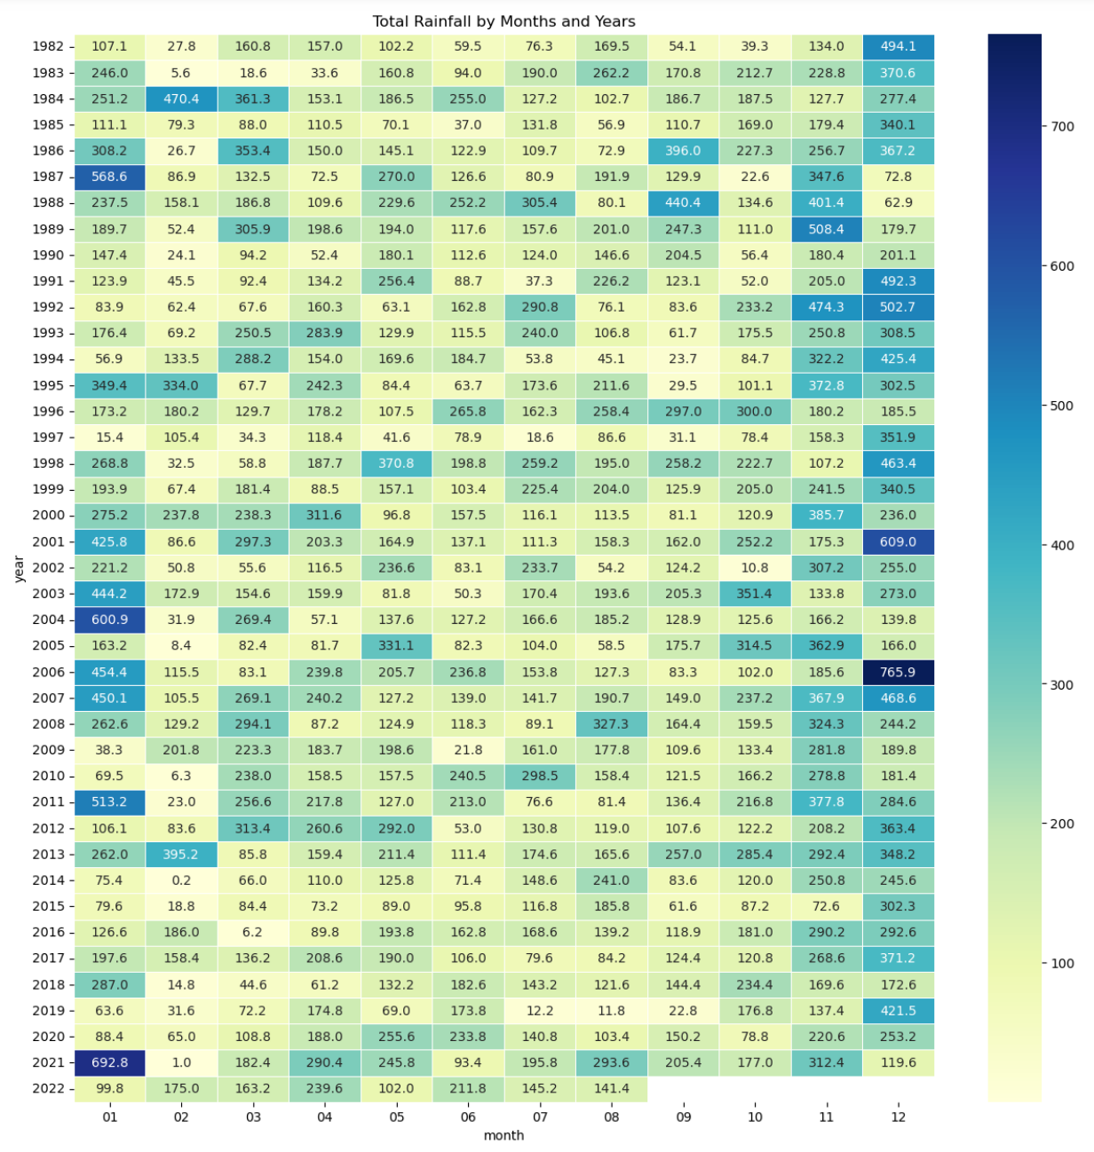
Visualization
Infographic Style
millimeters

Slide 7
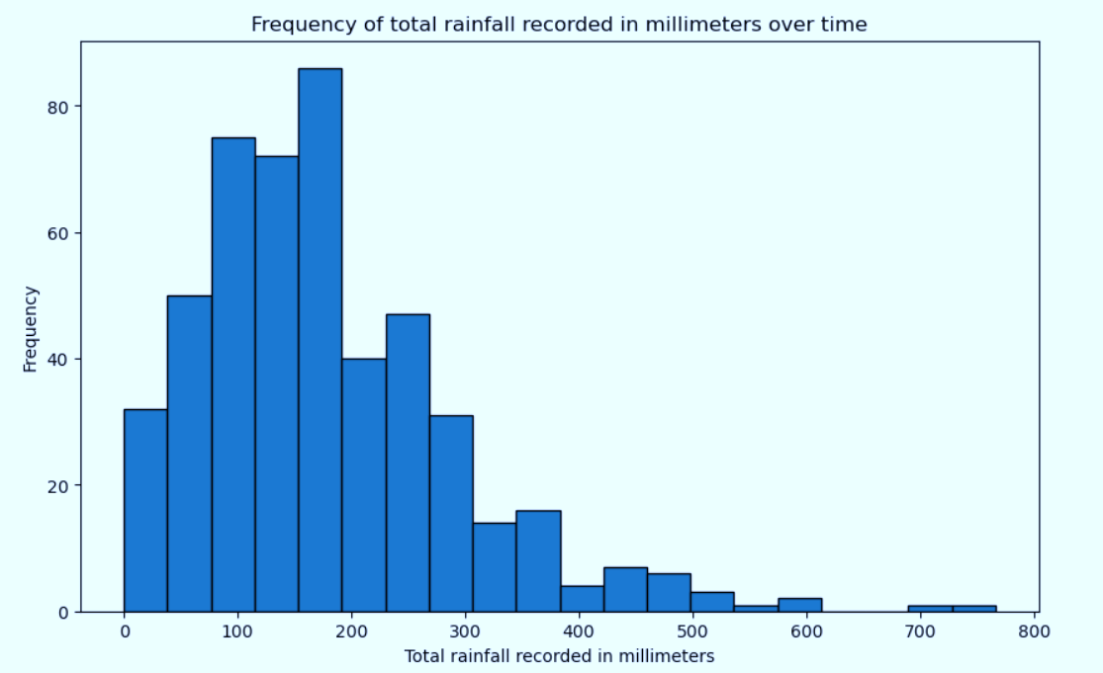
Visualization
Infographic Style

Slide 8
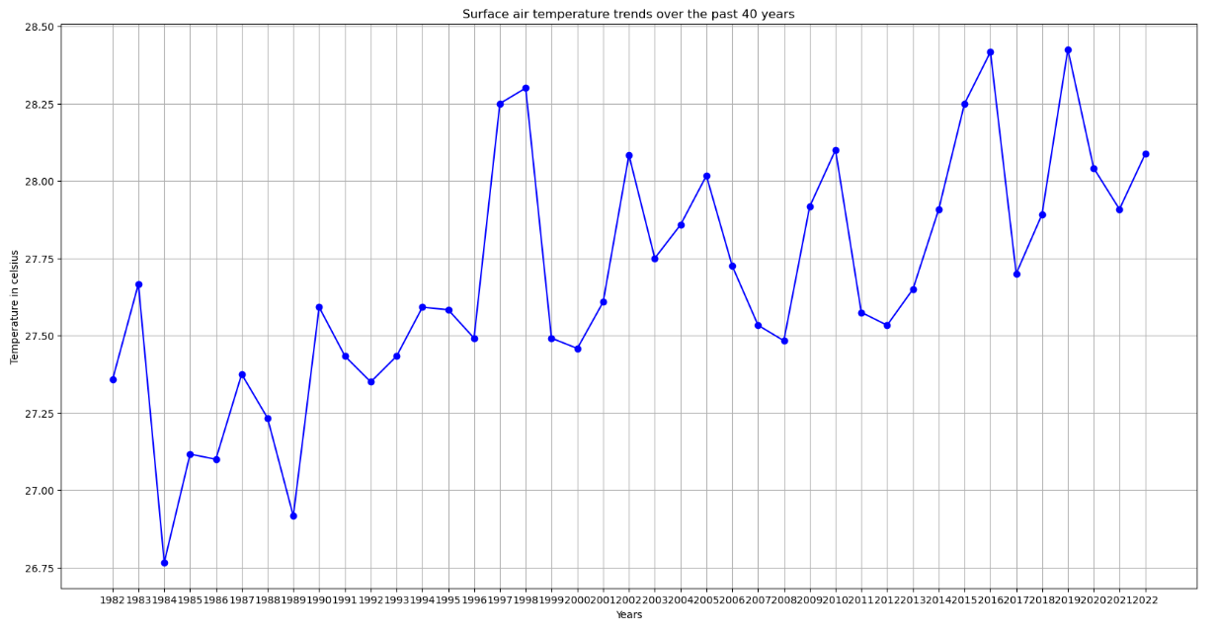
Visualization

Slide 9
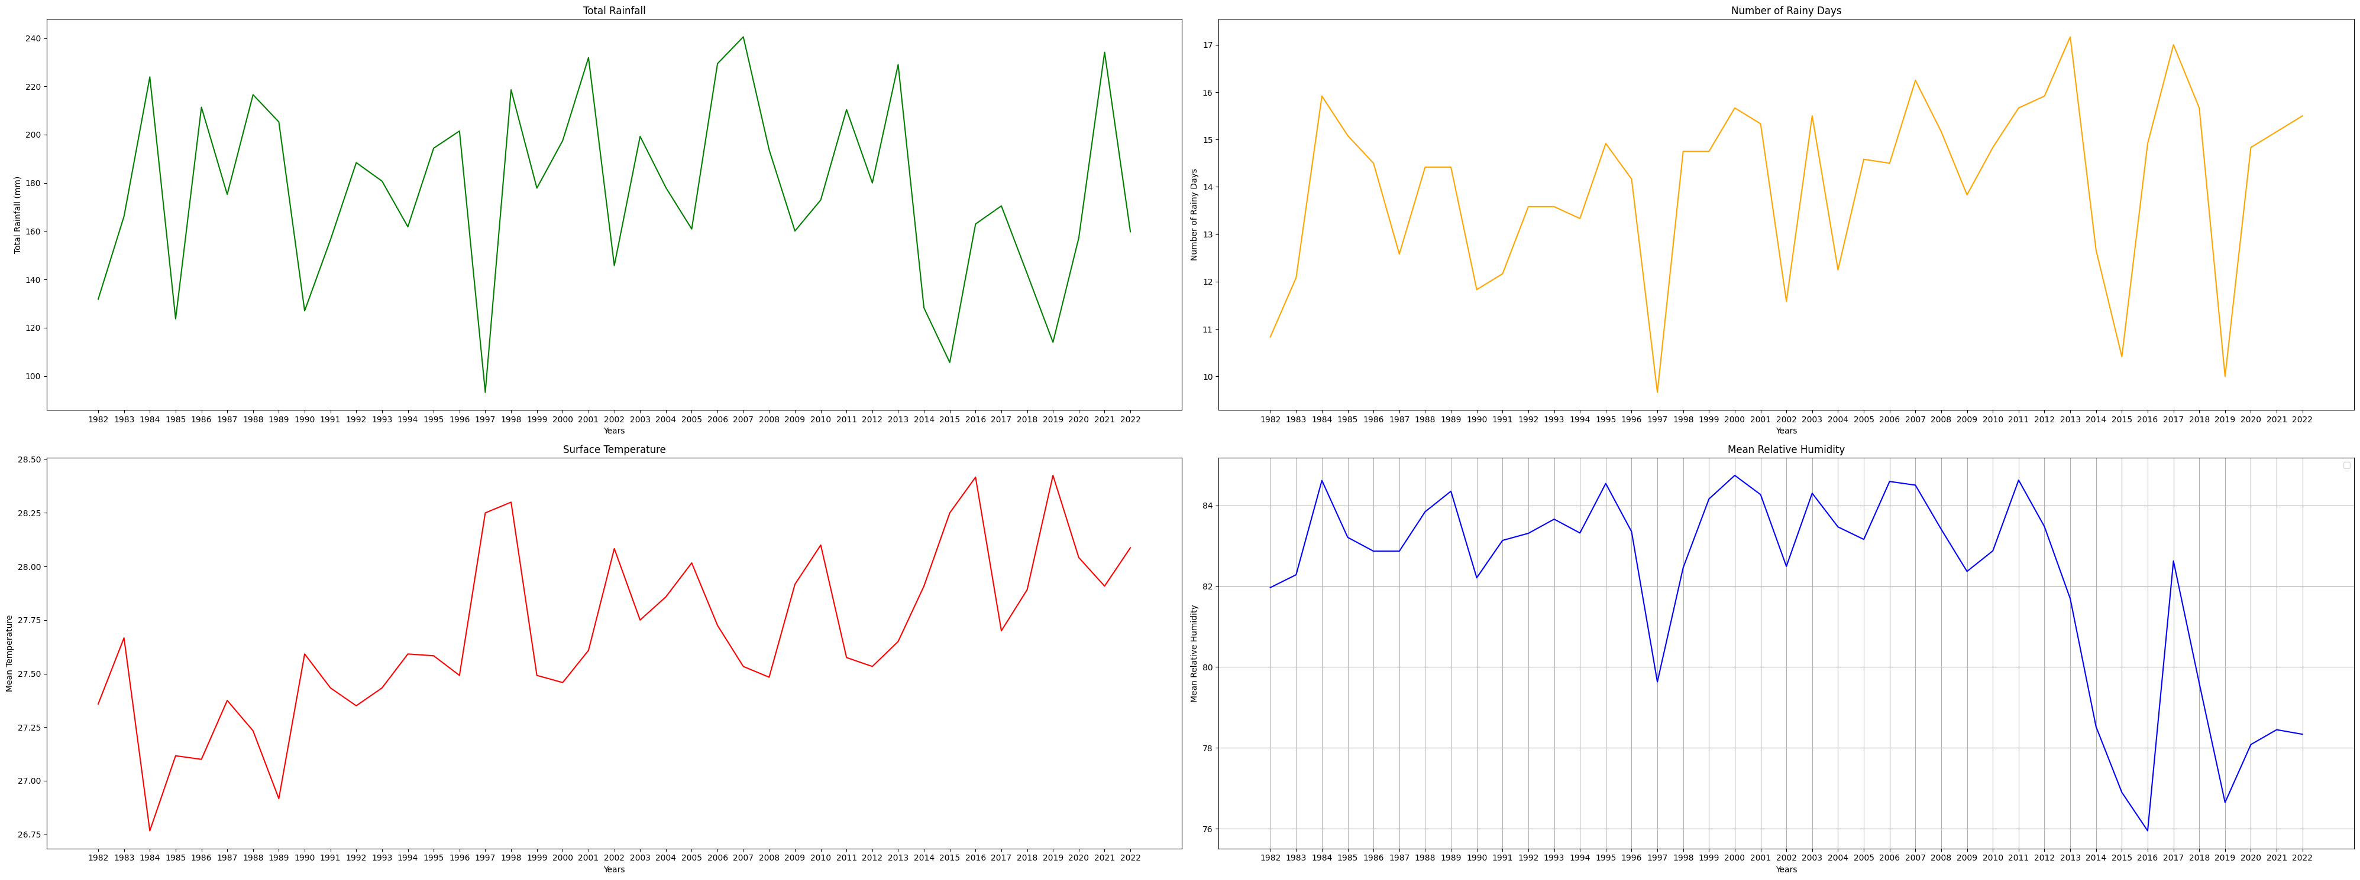
Visualization

Slide 10
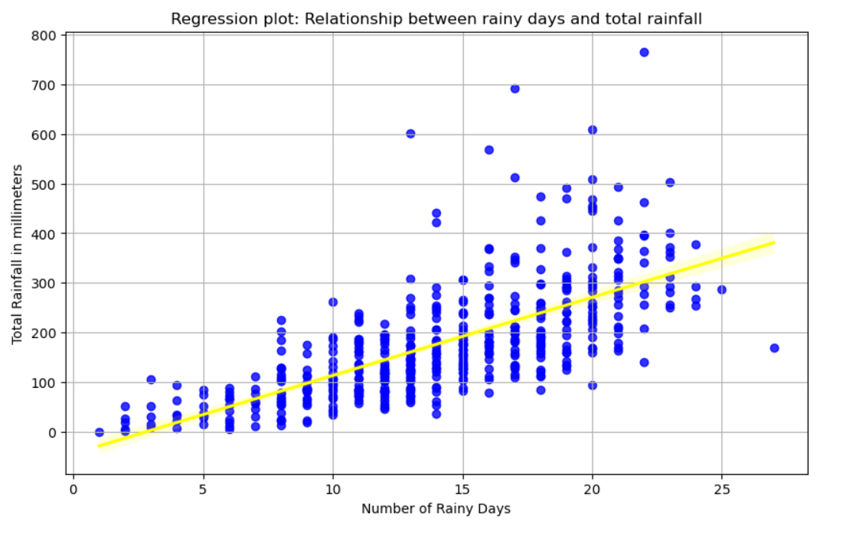
Visualization

Slide 11
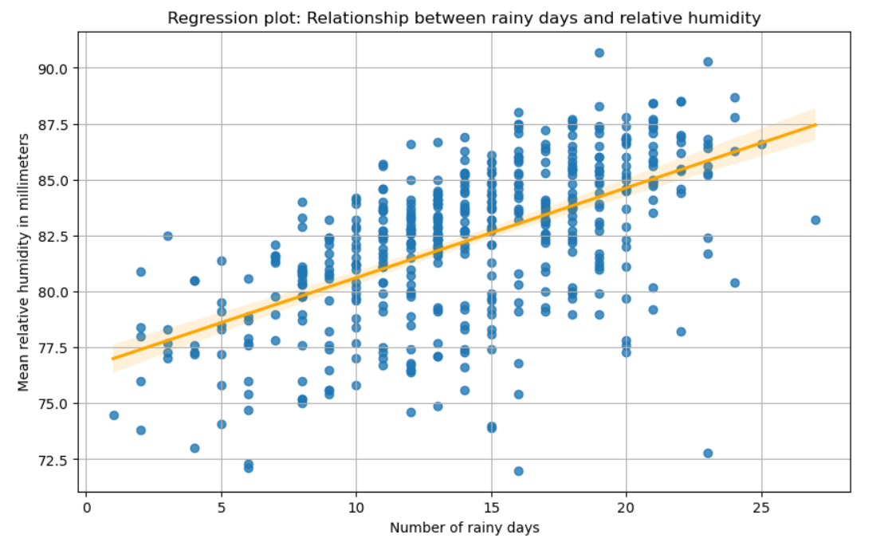
Visualization

Slide 12
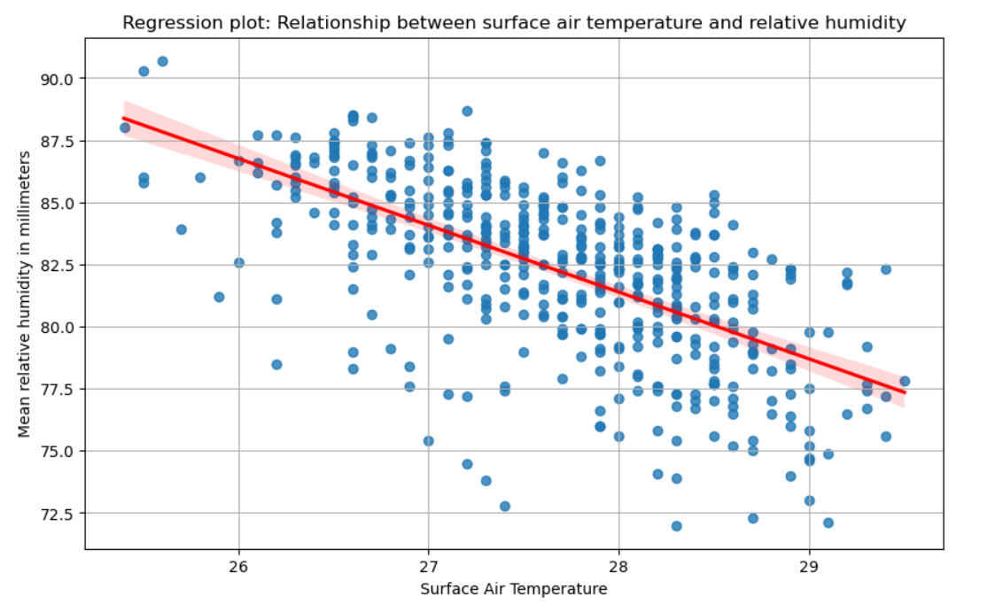
Visualization

Slide 13
Findings
Between November and January, in the northeast monsoon period, There will be more intense total rainfall than during other months in each year.
Temperatures have continued to rise over the past forty years which shows the problem of global warming that the whole world is experiencing.
During The Northeast Monsoon, there were higher intensity values for the number of rainy days, rainfall, and relative humidity than during the Southwest Monsoon and others.
Higher temperature has an inverse effect on lower relative humidity. It inferred that the temperature trend continues to increase. It will result in the rate of rain falling continuously.

Slide 14
Conclusion/Recommendation
November, December, and January
The government will have to prepare a rainwater collection pipe system, and reservoirs scattered throughout the island must be ready to accommodate as much rainfall as possible to create a freshwater reservoir.
Encouraging the agricultural sector to use rainwater in this period to care for agricultural land to reduce water use from other sources and for the industrial sector to use rainwater to conduct business and treat wastewater for reuse to reduce recycling costs to the cost of importing water from abroad.
Evaporation management is essential for a country with freshwater shortages and limited water resources when the temperature increases. The Singapore government should help support the development of modern technology from pulling water from the sea and distilling into freshwater , creating a water management plan and issuing a water control policy to reduce the loss and evaporation of water sources.
During these months are the periods when there is more overall rainfall than other months of the year.
Northeast monsoon season
In the Northeast Monsoon flow bringing major rainfall events.
Every months over the past 40 years
The trend of surface temperature is increasing every year.

Slide 15
Thank you

